Slide 1
Network of Evolvable Neural Units: Evolving to Learn at a Synaptic Level
2019.02.05
Suwhan Baek, KwangHo Lee
Bio Computing Lab
Kwangwoon University

Slide 2
Abstract
Various neural network architectures and optimization strategies are proposed with the explosive growth of the DNN.
But their underlying structure remains unchanged and is still different from the way real biological neurons mechanism and structures
Under the structure of basic Neural Network, this paper propose the improved model that less manually driven for the model that designed with lower level of abstraction.
With this proposed method model can approximate the function of each individual neuron and synapse
Mimic Integrate-And-Fire Neurons and synaptic Spike-Timing-Dependent Plasticity.
Possible to evolve an agent capable of learning to solve a T-maze environment task.
Notes:
Robust : reflection problem

Slide 3
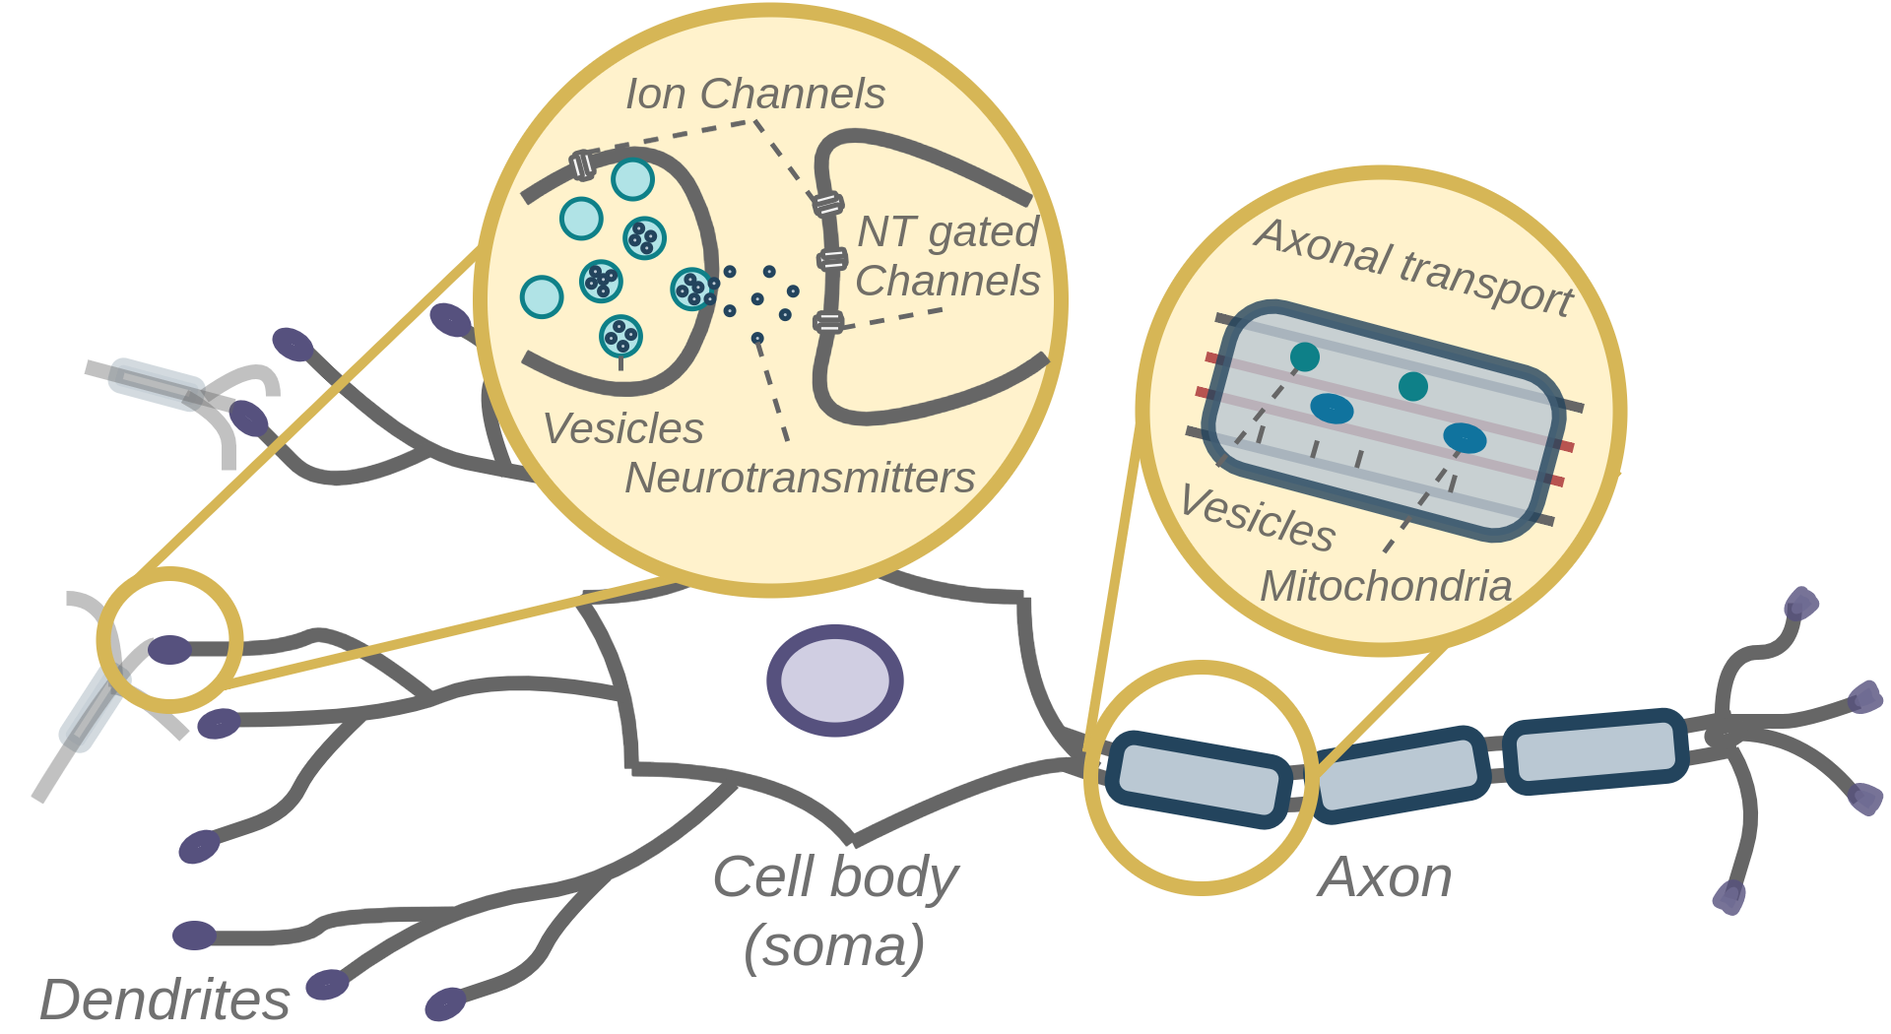
ENU cell
Notes:
Robust : reflection problem

Slide 4
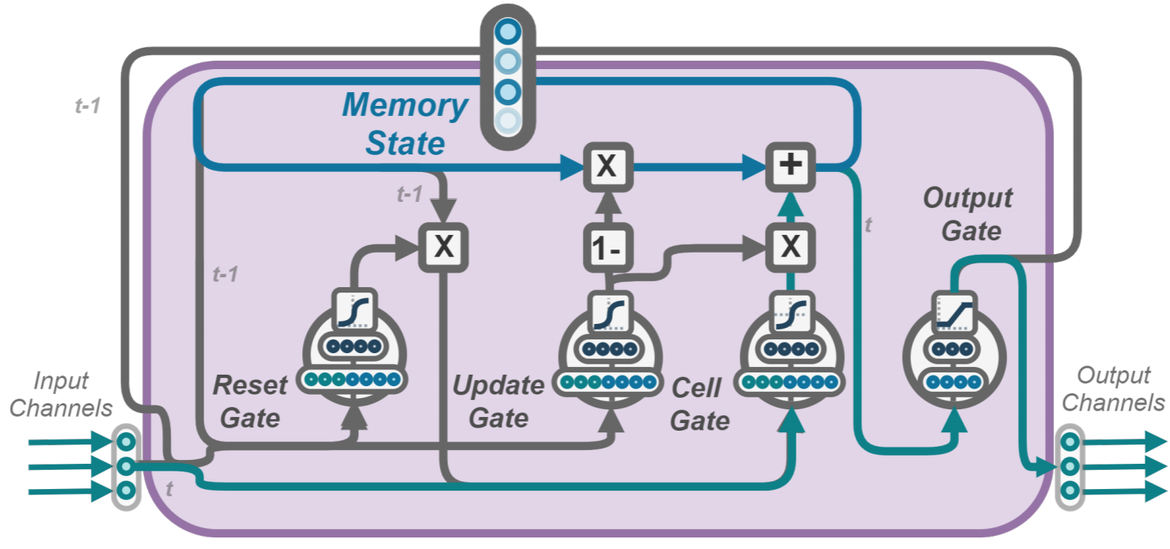
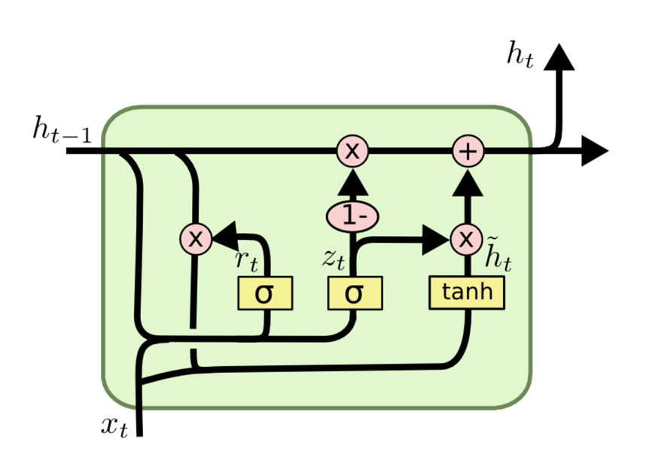
ENU cell
[ LSTM cell ]
[ ENU cell ]
Notes:
Robust : reflection problem

Slide 5
ENU cell
[ LSTM cell ]
[ ENU cell ]
clipping : restricting output values to be between 0 and 1
Notes:
Robust : reflection problem

Slide 6

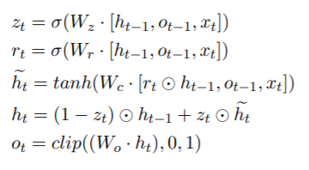
ENU cell
Shared Parameters
Have unique internal memory state
Output gate is used to reduce the number of output channels and allow for spike generation to potentially evolve
Notes:
Robust : reflection problem

Slide 7
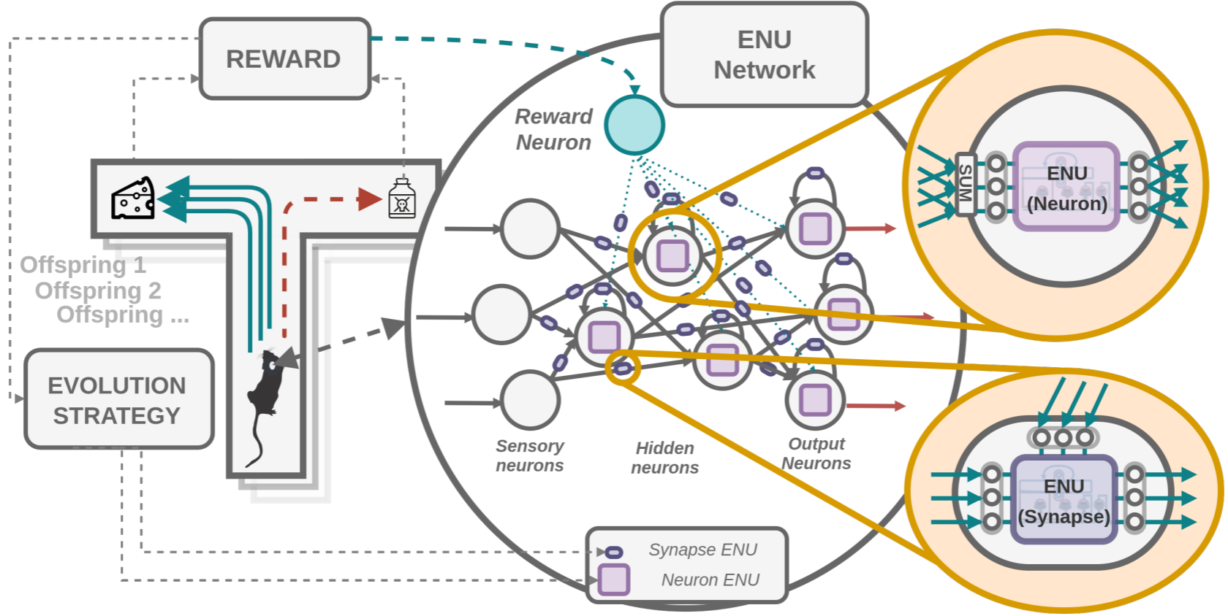
ENU Network
Notes:
Robust : reflection problem

Slide 8
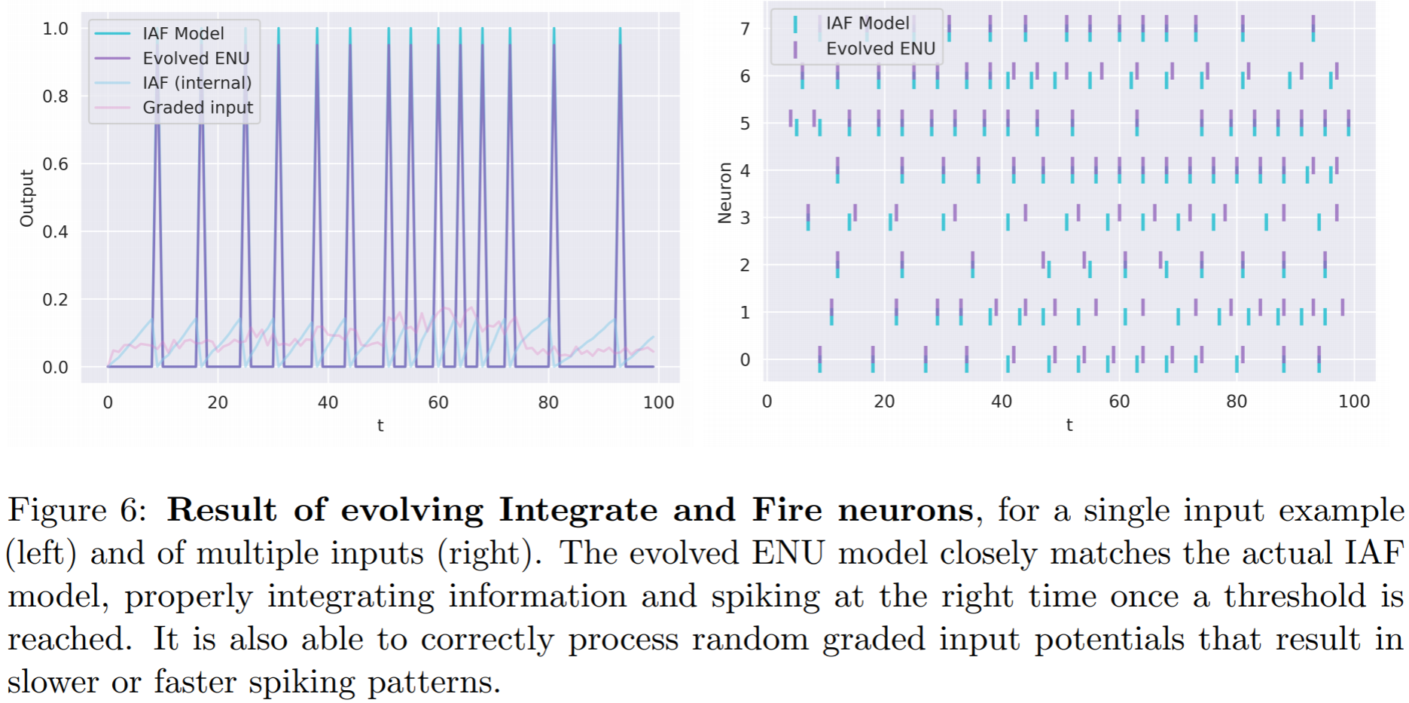
Experiment : Mimic IAF
Notes:
Robust : reflection problem

Slide 9
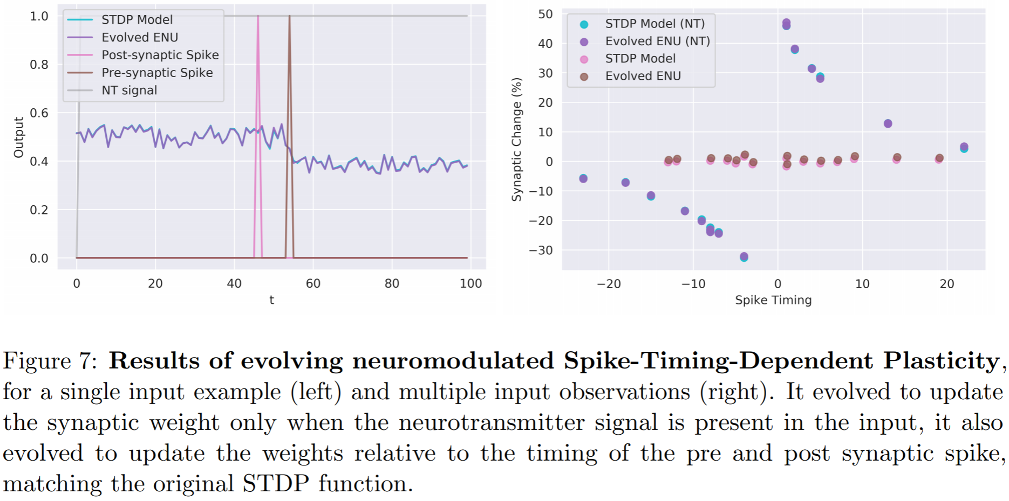
Experiment : Mimic STDP
Notes:
Robust : reflection problem

Slide 10
Comparison to other models
We evolve the ability of each ENU to update those dynamic parameters based on the reward obtained and local input received, unlike DNNs that use backpropagation over the entire network given some learning signal.
DNNs are thus not learning-to-learn but learn fixed behaviour instead,only applicable to the current environment. Additionally, to learn from reward signals usingdeep neural networks, reinforcement based learning methods like Deep Q-learning or Actor-Critic models are required
In our case the final evolved model is able to perform one-shot learning from a single experience to modify it’s behavior.
Able to update the synaptic compartments given the reward, which consequently enables it to alter the way information flows through the synapses and neurons (over multiple channels).
Notes:
Robust : reflection problem

Slide 11
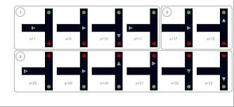
Discussion
This demonstrated that in principle an ENU is flexible enough to evolve neural like dynamics and complex processing mechanisms
his network of ENUs can be evolved to solve a T-maze environment task, which results in an agent capable of reinforcement type learning behaviour
The Evolvable Neural Units presented in this paper offer a new direction for potentially more powerful and biologically realistic neural networks
Notes:
Robust : reflection problem

